Slide 1
Project 0
Kinder
Tinder, but for kitties
Alfred Do

Slide 2
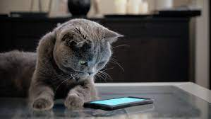
What was my project about?
A show of skill
Something fun and creative

Slide 3
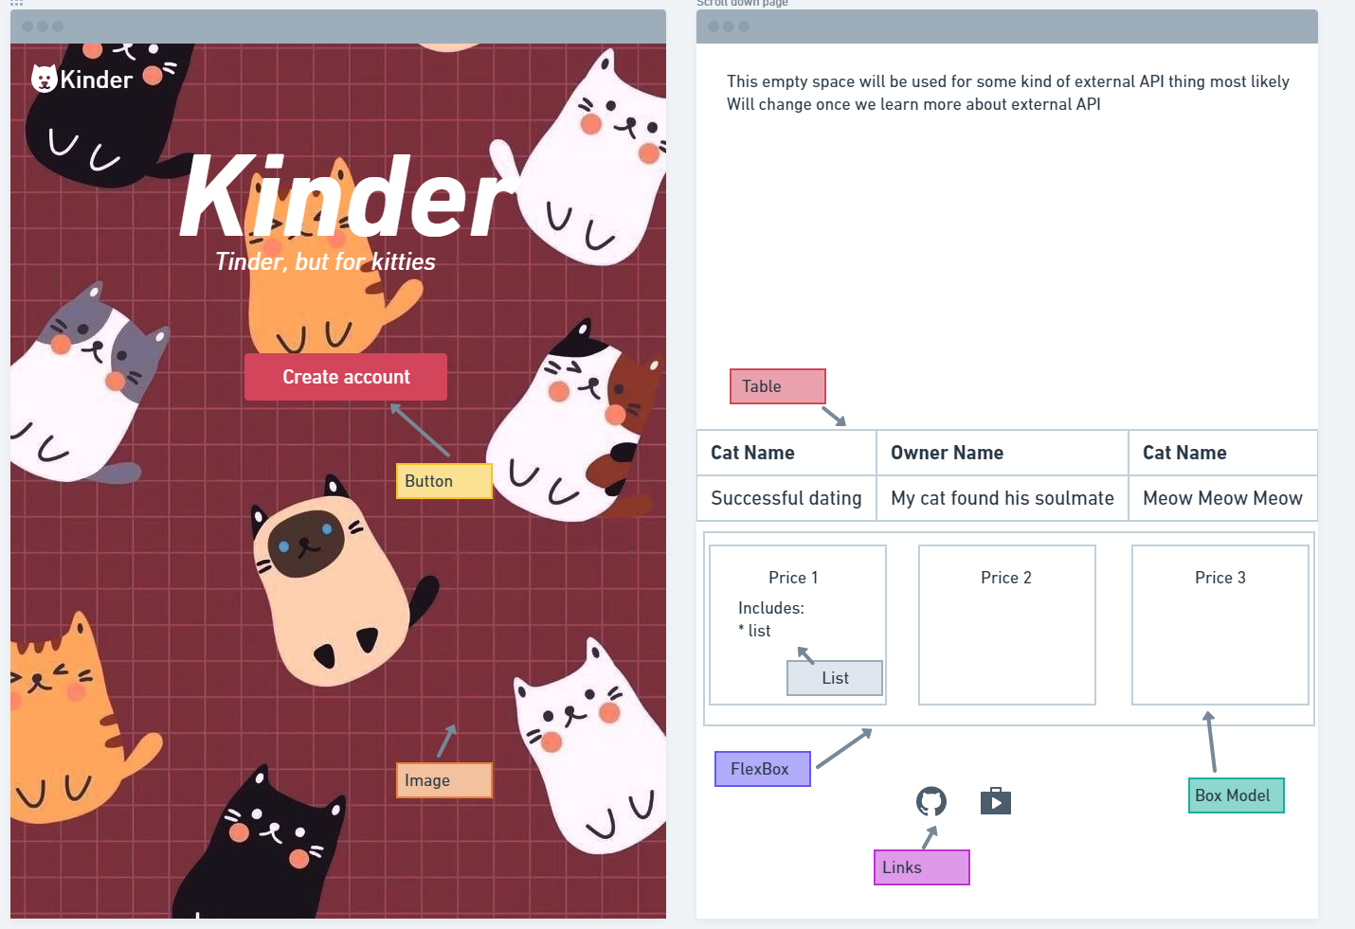
Live demo
YouTube API

Slide 4
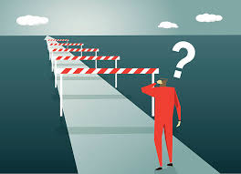
Roadblocks
Remembering
Looking up details on CSS
Lack of bootstrap
Difficulty with Javascript

Slide 5
Questions?

Slide 6
Thank you

